Slide 1
CIVIC TECH 101
Free reuse under Creative Commons
Attribution 4.0 Intl
Last Updated: Sept. 26, 2017
Notes:
Welcome to civic tech!
[do quick round of intros again - ask people to give name only]

Slide 2
Agenda
What is civic tech?
Why do we need it?
About Civic Tech Waterloo Region
What you can do
Resources
Questions & discussion

Slide 3
What is Civic Tech?
“...any technology that is used to empower citizens or help make government more accessible, efficient and effective.”
- Stacy Donahue, Omidyar Network
“...tools we use to create, support, or serve public good.”
- Laurenellen McCann, Open Technology Institute
Notes:
There are many definitions of what civic tech is
Here are two examples
the first is more specific, with regard to its reference to citizen empowerment and making government more accessible, efficient and effect
the second is more broad, related to any tool used to create, support, or search the public good
There are many different interpretations of what civic tech is, but at the end of the day it’s about using technology for the public good

Slide 4
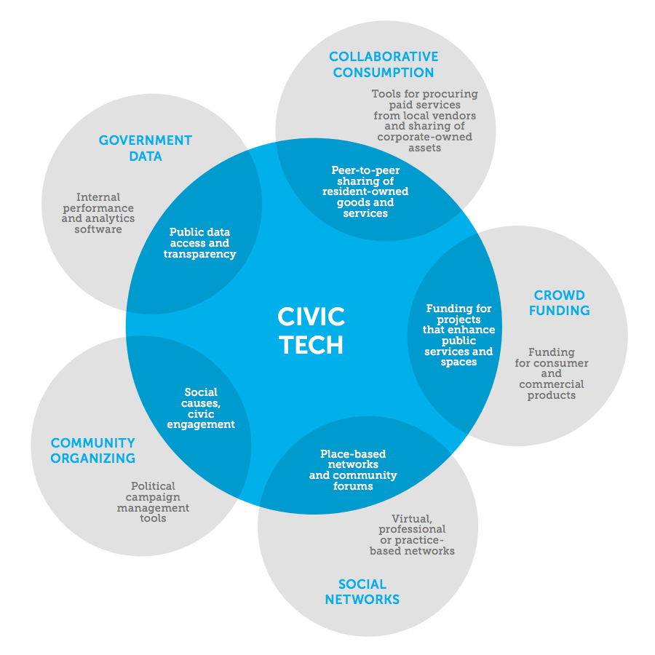
A convergence of fields
Source: Knight Foundation
Notes:
Here’s an infographic from the Knight Foundation, that illustrates how civic technology is a convergence of 5 fields:
Collaborative consumption
e.g. technology focus on peer-to-peer sharing of resident-owned goods and services
Crowd funding
e.g. technology that facilitates funding for projects that enhance public services and spaces
Social networks
e.g. place-based networks and community forums
Community organizing
e.g. technology geared towards social causes, civic engagement
Government data
e.g. technology that enhances public data access and transparency

Slide 5


Where do I fit?
design
strategists
UI/UX designers
legal professionals
artists
tech
policy
policy experts, policy interested
data analysts
organizing
community organizers, liaisons
developers
project managers
Everybody can contribute
Notes:
You might be wondering, where you fit in, or what you can do.
Civic technology involves a multidisciplinary approach to solving civic issues
It primarily involves technology, design, policy analysis and community organizing, but at the end of the day, everyone can contribute to civic technology
Listed on the slide are a few examples of roles that are critical to make civic tech project successful

Slide 6
Why do we need civic tech?
Limited resources in public & non-profit sector
Governments less agile
Changing needs of citizens
Enables increased public participation
Opportunities to leverage data & tech
Notes:
Why do we need civic tech?
First, there are limited resources available in the public and non-profit sector
Organizations in this space typically aim to address civic issues, however, they are increasingly being forced to do more with less. Civic technology helps these organizations become more efficient and effective in achieve their goals.
Second, governments are not agile
They are less responsive to address civic issues, and it’s much more efficient for citizens like us to implemented solutions to civic issues
Third, the needs of citizens are changing
This is related to the previous point
We are living in an increasingly digital world, and organizations that deliver public services need to rethink their approach to service delivery
Existing methods of service delivery are still very manual and time-consuming
Another reason why we need civic technology is because of what is can enable. First, it enables increase public participation.
Technology allows people to connect instantly with one another, and makes way for new forms of digital public participation.
Lastly, civic technology provides opportunities to leverage existing data and technology
Government have a wealth of data, the potential of that data is untapped
Technology enables us to better analyze information, which hopefully will lead to better policy making and a more informed public

Slide 7

Use the internet for good.
To take action on civic issues
To inform ourselves + others
To build tools that empower communities + individuals
To share open source code with the commons
To improve on the work of existing groups + institutions
Notes:
The Internet, is for the most part neutral infrastructure - it can be used to enhance freedom, or corrode it.
Think of NSA’s mass data collection, or the Hacking Team’s sale of cell phone monitoring software to repressive regimes.
On the flipside, we have tools that empower communities, contribute open source code to the commons, and support the work of existing groups and institutions.
------ #emily’s notes on this slide below
Some might view the internet as a bad thing. When we think about hackers, and all the potential threats to privacy and security online. An important aspect of civic technology is about reclaiming technology and using it for good. When we talk about civic hacking, it’s less about doing damage, and more about building tools that challenge the status quo and empower citizens.
Civic technology is more about using the internet to…[read bullets]

Slide 8
Built with, not for.
Civic tech is about empowering citizens through learning, teaching and collaborating
Built for
Built with
Built by
Notes:
Laurenellen McCann, a fellow at the Open Technology Institute (an initiative of a really cool think tank called the New America Foundation), coined the phrase “Built with”. She was inspired by some legendary community organizers - Saul Alinksy & Grace Lee Boggs among them - who fought to empower otherwise disenfranchised communities.
------ #emily’s notes on this slide below
A key tenet of civic technology is the notion of building with, not for
This term was coined by Laurenellen McCann, a fellow at the Open Technology Institute
Sometimes, when we see a problem, it easy for us to jump to conclusions about what the solution should be
But, when we built civic technology, we should be cognizant of the potential consequences of our actions and be sure to involved the communities that would be impacted by our technology
[cite Street Bump example:]
The City of Boston created a now “infamous” app called Street Bump to detect potholes using smartphone sensors. But not everyone has a smartphone or the capacity to download apps or the digital literacy to use them as intended. The result? Potholes in wealthier, whiter, younger neighborhoods were detected, directing city services to these more privileged neighborhoods and leaving neighborhoods that were already underserved (especially in terms of their infrastructure upkeep) further disadvantaged.
https://medium.com/@elle_mccann/crafting-civictech-7f5edfb864bb#.nl6gfks0s
Often, civic tech projects start out as builting solutions for another community, however, they should be built with communities, and ideally, built by the communities themselves

Slide 9


About Civic Tech Waterloo Region.
Group of volunteers interested in finding solutions to civic challenges through technology and design
Monthly hacknights since September 2017
We would love to increase the frequency – these projects take a LOT of time!
Hub for all things civic tech and Resource for civic tech projects
Workshops
Information & Advice
Community Network

Slide 10
Who we work with.
Educational Institutions
Civil Society Groups
Individual Citizens
Government
Tech Companies

Slide 11
What are we looking to do?
Create projects with impact
Let’s make change happen!
Keep in mind:
Embrace and celebrate the process! Making real change on an important issue, coming together as volunteers, learning about policy, learning tech skills.
Reorganize the process so that these things (education, community) support long-term outcomes + support hackathons
Fail forward
Notes:
What we’re looking to do is create projects with impact!
it’s a tall order, but it’s what we’re commited to doing and it’s the only way that real change can happen
A few things to keep in mind
Embrace and celebrate the process of making real change happen
Focus on supporting long-term outcomes
a common criticism of hackathons is that they don’t provide adequate means for winners and participant to make progress post-hackthons
at civic tech toronto, we’re here to support hackathon projects so that they can actually achieve long-term outcomes - it’s one of the reasons why we meet every week
hackathons participants are welcome to come to our hacknights and continue to work on their projects here and collaborate with others
Fail forward

Slide 12






Tools we use.
meetup.com/CivicTechWR
facebook.com/CivicTechWR
twitter.com/CivicTechWR
CivTe.ch
CivicTechWR.slack.com
hello@civte.ch
github.com/CivicTechWR
Notes:
There’s a number of tools that we use to help our community and project thrive:
Slack
If you aren’t already familiar, it’s a chat tool that enables members to join topic-specific chatrooms, which are called channels, and directly message other members
This is a great tool that enables us to keep in touch with each other outside of the hacknights
Github
We use Github to keep track of all our documents and code
If you haven’t used Github before, it’s a web-based version control system. It’s primarily used for tracking code, but can also be used to other documents
Meetup.com
If you haven’t already, please join our meetup.com group
This is where we post the most up-to-date information about our hacknight every week
Web
We have a website that has more information about civic tech waterloo region and blog posts about our hacknights
If we have a speaker at the hacknight, we’ll usually take a video and upload it to the blog afterwards, so if you can’t attend a hacknight, visit the blog to catch up on what you missed
Twitter
Tweet at us @civictechwr!
Email
If you’d like to get in touch with us through email, send us a line at hello@civte.ch

Slide 13
Where and when?
Where: we’re a bit nomadic (on purpose)…
… join our meetup.com group to know where we are
When: Tuesday’s @ 5:30pm
Once a month meetup = CONSISTENCY*
* This is a big thing and we hope to increase the frequency as membership and interest grows as these projects take time… lots!

Slide 14
What can you do?
Be kind, helpful and constructive
Read our Code of Conduct & Anti-Harassment policy – up for additions/edits
Own a project. Join a Project. Connect people & resources.
Invite others & go to them > silo-busting
Work in between meet-ups
Connect to City and government processes

Slide 15

Some ways to get started.
Look for finished projects in other cities, adapt wholesale or localize
Connect with speakers and their community, find inspiration for projects
Identify information gaps in public discourse (e.g. scraping data for use by journalists), in your community
Listen to what’s going on in your community, look for ways to connect with other communities with needs
Notes:
If you’re interested in starting your own projects, here are some ways to get started…

Slide 16

Danger zones.
Tech Savior Complex
Starting from Zero
Not defining your problem or your user (design!)
Downtown-centric
Team All Tech or Team All Policy

Slide 17
Helpful links.
http://www.opennorth.ca/
https://represent.opennorth.ca/
https://openparliament.ca/
http://bit.ly/toronto-open-data-catalogue
http://poplus.org/
http://sunlightfoundation.com/
https://www.mysociety.org/
http://www.buildwith.org/
http://www.codeforamerica.org/blog/2015/12/22/this-year-in-civic-tech-2015-in-review/
Update with relevant links

Slide 18
Some ongoing projects.
Project | Lead(s) | Description / Needs
Civic Tech 101 | Doug | Come here if it’s your first time!!!!
Future Tech | Kristina | Brainstorm new and future projects
Food | Theresa | XXXXX
Update with current projects and names

Slide 19
Thank You Questions?

